Slide 1
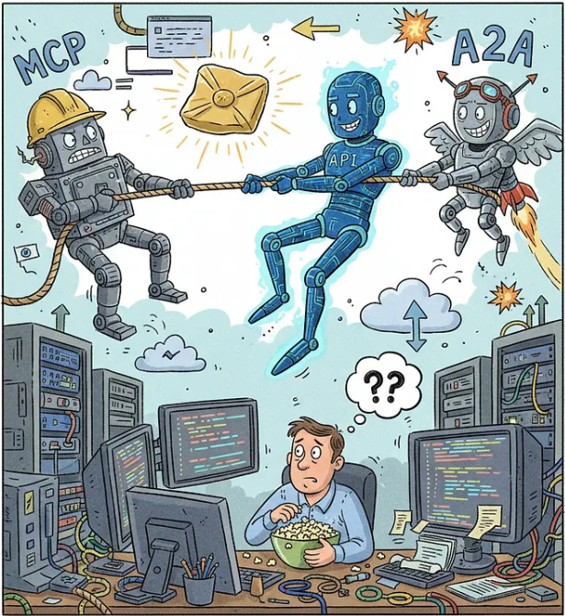
API DUBLIN MEETUP
Rest API vs MCP vs A2A (Agentic AI)
SREENI KAND
Organizer: https://www.meetup.com/api-dublin/
Blog: CUT CLUTTER IN TECH
https://blog.dbkompare.com
www.dbkompare.com
Work : Director – Enterprise Data Architecture Afiniti AI Ltd

Slide 2

AGENDA
Bit of History of each technology
Architecture of RESTAPI
Architecture of MCP
Architecture of A2A
How they fit in an application
Recap & Questions ?
DEMO !

Slide 3
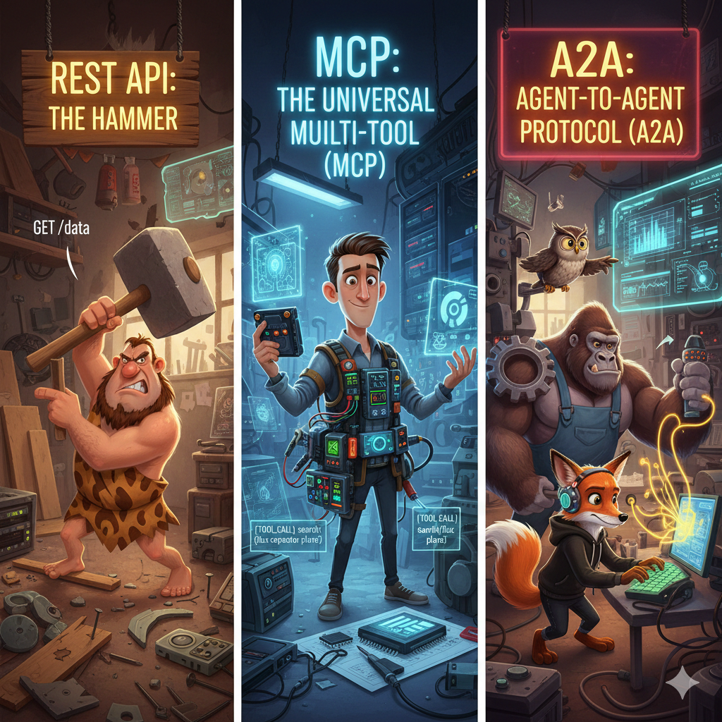
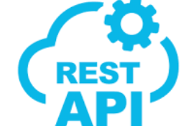
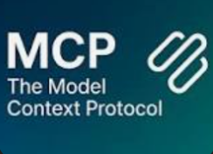
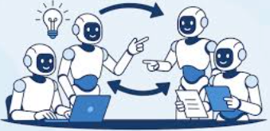
Rest API vs MCP vs

Slide 4
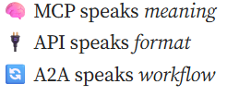
Bit of History & Comparision
Protocol | Start Date | Who launched | Main Use-Case | Architecture Style | Key Competitors / Preceding Tech
REST API | ~2000 (Fielding) | Roy T. Fielding / web dev community | Client–server web services, resource access | HTTP request/response, stateless, uniform interface | SOAP, RPC, CORBA, custom HTTP/XML
MCP | Nov 2024 | Anthropic | LLM/agent ↔ external data/tools integration | JSON-RPC, clients & servers, tool invocation | Custom connectors, vendor-specific tool APIs
A2A | 2025 | Google (via Linux Foundation) | Agent ↔ agent communication/collaboration | Peer messaging, agent discovery, async workflows | Custom multi-agent orchestration, event-bus only solutions

Slide 5
REST API
Architecture
Key constraints include client-server separation, statelessness, cacheable responses, layered system, uniform interface, optionally code on demand.
Communication is typically over HTTP using resource identifiers (URIs) and standard HTTP methods (GET, POST, PUT, DELETE).
Architecture is synchronous request/response, decoupled components, with emphasis on scalability and simplicity.
Popular open-source on-prem libraries
In Java: Jersey (JAX-RS reference implementation)
In Python: FastAPI (released 2018)
In JavaScript/Node: Express.js (popular for building REST APIs)
API Gateway frameworks: Kong, Tyk, Apache APISIX etc.

Slide 6
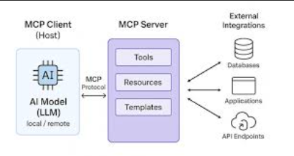
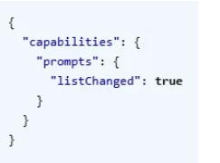
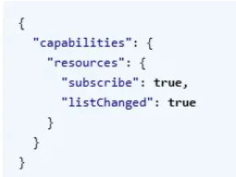
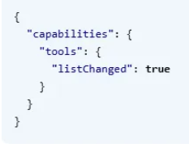
MCP Model Context Protocol
Architecture
MCP is oriented “vertically” from an agent/model to external resources. It enables a standard interface to connect large-language models / agents to contexts (files, databases, APIs, functions).
Protocol style: uses JSON-RPC 2.0, supports transports like HTTP, stdio, server-sent events etc.
Architecture: you have MCP servers exposing data/tools, and MCP clients (LLMs/agents) consuming them. This reduces the coupling of custom integrations.
Focuses on enabling an AI system to call tools, fetch context, act on data with much less glue code.
3 capabilities to be published as per PROTOCOL
Popular Implementations
Spin up Azure resources using
https://github.com/Azure/azure-mcp

Slide 7
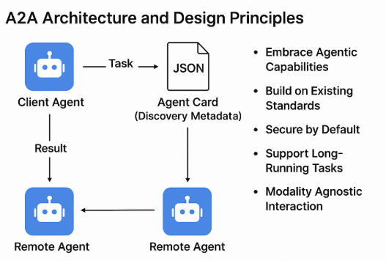
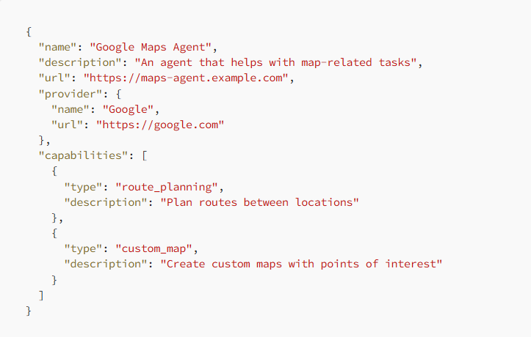
A2A ( Agent 2 Agent Protocol
Agent CARD as per PROTOCOL
Architecture
A2A focuses “horizontally”: how agents communicate with each other, delegate tasks, collaborate, discover one another.
Key features: agent discovery ("Agent Card" metadata), secure peer-to-peer messaging, streaming, asynchronous workflows, multi-agent orchestration.
Architecture: Agents register capabilities, send/receive structured messages (JSON-RPC or HTTP/SSE), peer networks, possibly event/stream driven rather than purely synchronous API calls.
Popular libraries
The a2aproject/A2A repository (Apache-2.0) is an open-source reference.

Slide 8
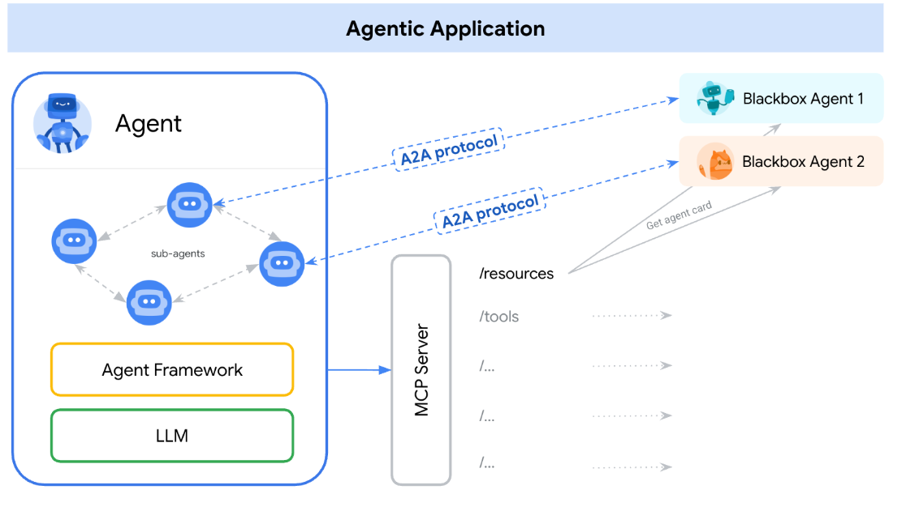
How they work together in an application ?

Slide 9
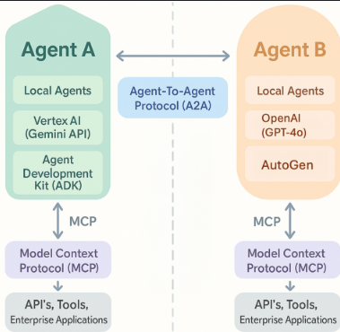
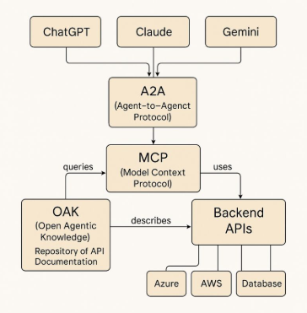
How they work together ?

Slide 10
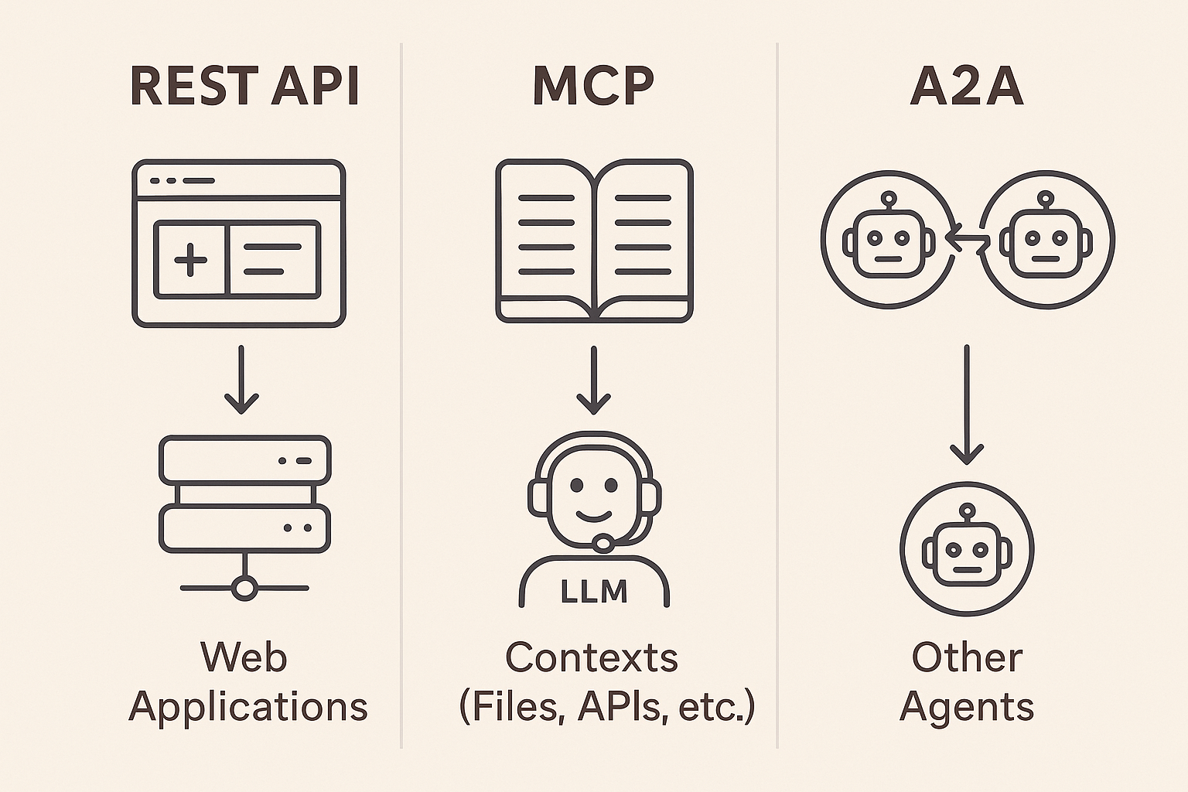
Key Takeaway for todays Meetup

Slide 11
DEMO & Questions ?
https://www.meetup.com/api-dublin/
https://blog.dbkompare.com

Slide 12
Architecture Diagram

Slide 13
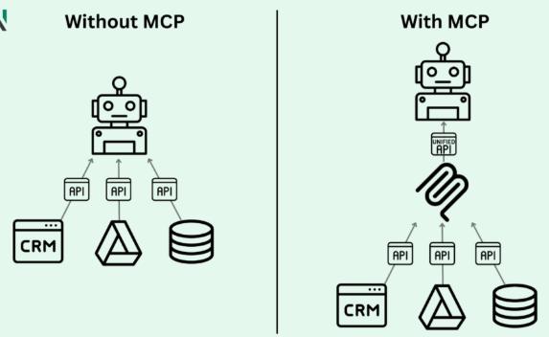
Architecture Diagram

